Slide 1

Analysing Weather Conditions and Consequences of Climate Change with ClimateWins
By Andreas Tocci

Slide 2

Introduction
ClimateWins has been sorting through hurricane predictions from The National Oceanic and Atmospheric Administration (NOAA) in the U.S., typhoon data from The Japan Meteorological Agency (JMA) in Japan, world temperatures, and a great deal of other data. However, it’s hard to grasp how everything is changing in the world at once.
In this presentation we will run through how I have used machine learning to try and unlock the understanding of how our world is changing and predict the tendencies of climate change in Europe and potentially the world!

Slide 3
Hypotheses
MACHINE LEARNING ALGORITHMS WILL BE ABLE TO ACCURATELY PREDICT FUTURE WEATHER CONDITIONS.
PREDICTION ACCURACY WILL VARY BASED ON GEOGRAPHIC LOCATION AND VARIOUS CLIMATE CONDITIONS WITHIN THE REGION.
MACHINE LEARNING CAN IDENTIFY SIGNS OF CLIMATE CHANGE AND ITS ADVERSE EFFECTS.

Slide 4
Data Set Utilized for the Analysis
This data is collected by the European Climate Assessment & Data Set project
Recordings exist for almost every day with values such as temperature, wind speed, snow, global radiation, and more
Contains data ranging from the late 1800s to 2022
Data set is based on weather observations from 18 different weather stations across Europe

Slide 5
Data Biases And Accuracy
Data Collection – Human Error is something that is ever present in data collection and could skew the data. Things such as misspellings, wrong values placed in the wrong categories and so on and so forth.
1
Sample Size – There are over 800 cities in Europe a sample of 18 cities could be unrepresentative especially if multiple reside in the same country
2
Data uniformity – Machine Learning needs data to be uniform to perform optimal analysis
3
Temporal Bias - As we are analyzing weather conditions historical data past a certain threshold is unrepresentative of present times.
4
Regional Bias – Larger or Richer countries will have more data than poorer and smaller countries i.e., Data for Vanuatu won't be as abundant and thus accurate as data for Germany
5

Slide 6
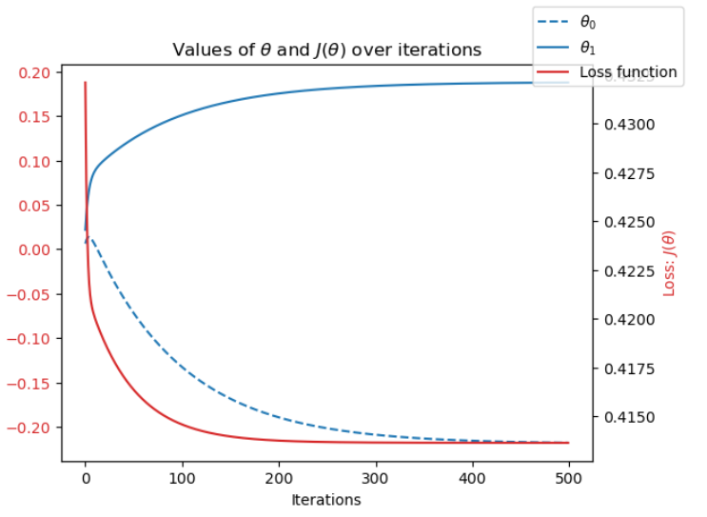
Data Optimization
The models where optimized through a method known as Gradient Descent. Gradient Descent adjusts the parameters to minimize loss (distance between the prediction and actual answer). This is done through Iterative updates to its parameters, to converge to optimal parameters which in this case are 0 or as close to 0 as possible.

Slide 7
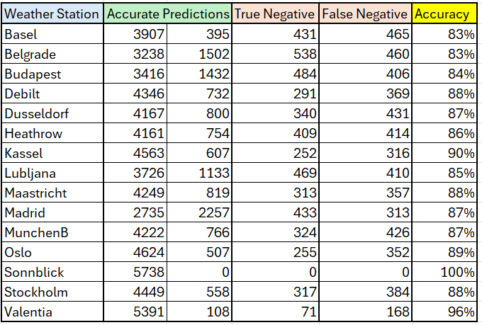
Model 1: K-Nearest Neighbor (KNN)
K-nearest neighbor algorithm(KNN) makes predictions by calculating the distance between new data points and all other data points in the training set. Nearby data points are grouped based on the number of neighbors in each group.
To improve accuracy and remove the disparity between weather stations, the training model must incorporate for varied data and include a wider range of weather conditions across more regions.
Average Accuracy - 88%

Slide 8
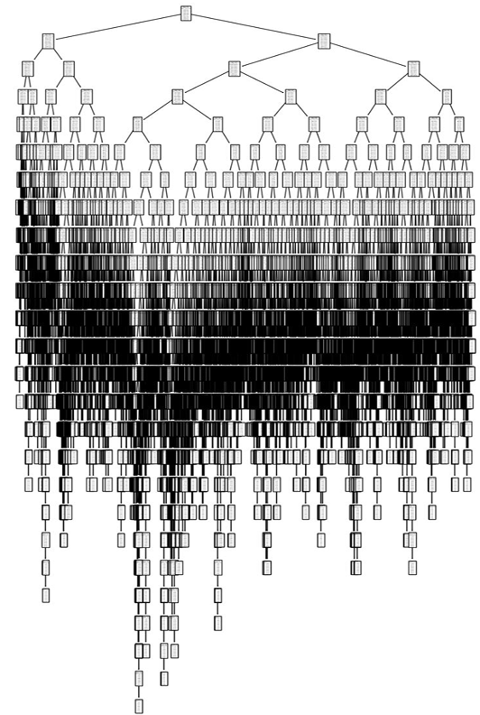
Model 2: Decision Tree
A Decision Tree takes all data points and posses questions (Yes/No) to categorize each specific situation to its best fit as it travels down its nodes and branches to its optimal position.
This leads to almost impossible interpretation of the model as the data set is very large making it unpractical.
The size of the data also makes it difficult and not cost effective to run.
Average Accuracy – 47%

Slide 9
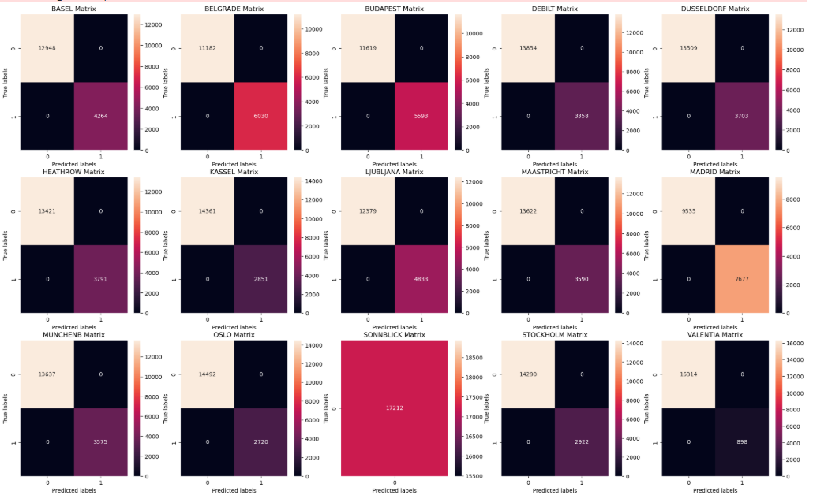
Model 3: Artificial Neural Network (ANN)
Artificial Neural Network (ANN) is a computer model that mimics the way the human brain processes information.
It consists of layers of interconnected "neurons" that learn patterns from data through training.
By adjusting connections between neurons, it improves its ability to make predictions or classifications.
Average Accuracy – 48%
Upper Left – Accurate Pleasant
Bottom Left – Inaccurate Unpleasant
Upper Right – Inaccurate Pleasant
Bottom Right – Accurate Unpleasant

Slide 10
Summary
MACHINE LEARNING ALGORITHMS CAN PREDICT FUTURE WEATHER CONDITIONS ACCURATELY (KNN HAVING 88% AVERAGE ACCURACY).
PREDICTION ACCURACY IS VARIED BASED ON GEOGRAPHIC LOCATION AND VARIOUS CLIMATE CONDITIONS WITHIN THE REGIONS. ALL CITIES HAVE VARIED ACCURATE PLEASANT AND UNPLEASANT PREDICTIONS.
MACHINE LEARNING CAN IDENTIFY SIGNS OF CLIMATE CHANGE AND ITS ADVERSE EFFECTS BY COMPARING UNPLEASANT WEATHER CONDITIONS OVER TIME.

Slide 11
Next Steps
• Incorporate unsupervised machine learning algorithms
• Diversify data points to include other variables for analysis
• Continue testing adjustments to increase model accuracy
• Observe more weather stations to increase machine learning capabilities

Slide 12
Thank You
Git Hub - AndreasTocci/Machine-Learning-With-Python-Weather-Analysis
Email – Andreas.Tocci@outlook.com

